Slide 1

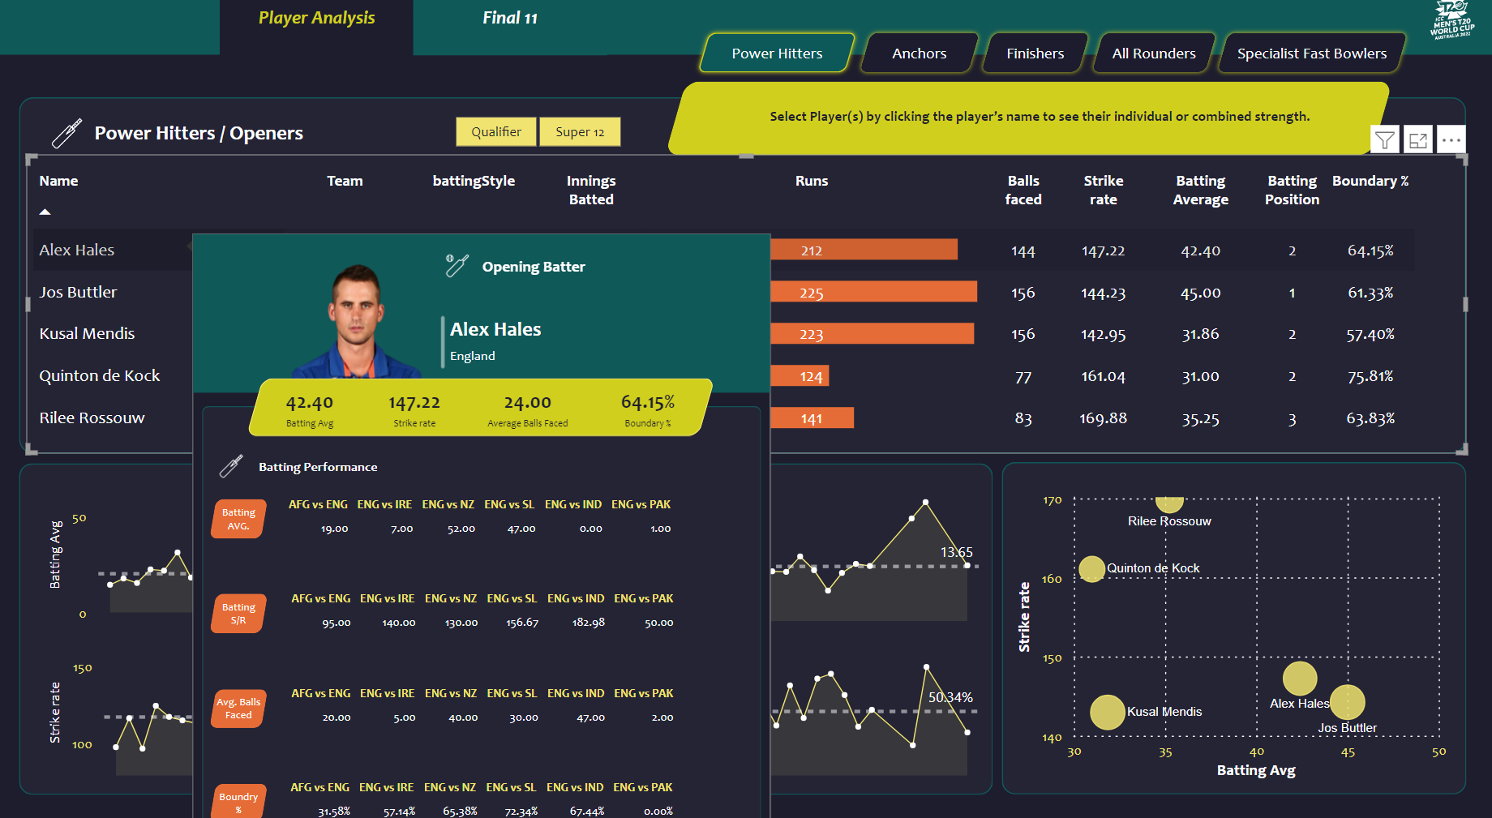
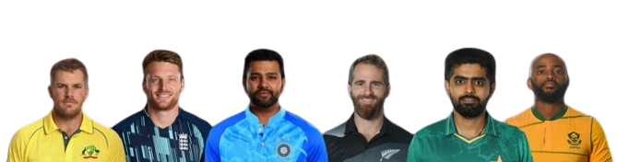


Cricket Best 11 Dashboard
T20 World Cup Cricket Data Analysis
View in Power BI
Last data refresh:
5/12/2024 3:33:07 PM UTC
Downloaded at:
5/14/2024 4:22:32 PM UTC

Slide 2
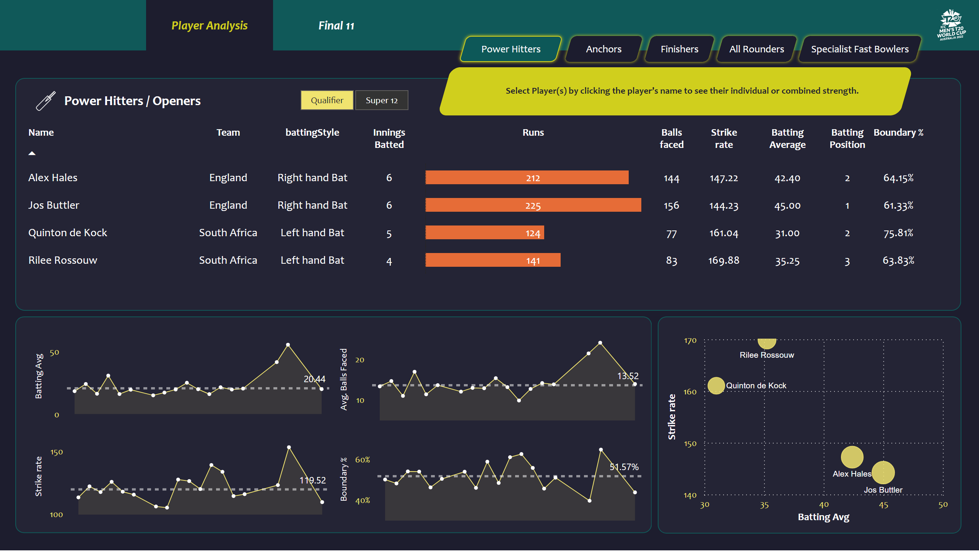
Project - Sportan
Notes:
slicer
No alt text provided
image
No alt text provided
shape
No alt text provided
actionButton
No alt text provided
actionButton
No alt text provided
actionButton
No alt text provided
actionButton
No alt text provided
actionButton
No alt text provided
shape
No alt text provided
shape
No alt text provided
card
No alt text provided
card
No alt text provided
card
No alt text provided
card
No alt text provided
shape
No alt text provided
areaChart
No alt text provided
shape
No alt text provided
areaChart
No alt text provided
areaChart
No alt text provided
areaChart
No alt text provided
shape
No alt text provided
image
No alt text provided
shape
No alt text provided
tableEx
No alt text provided
scatterChart
No alt text provided
Button Player Ana selected
No alt text provided
Button Player Ana selected
No alt text provided
shape
No alt text provided

Slide 3
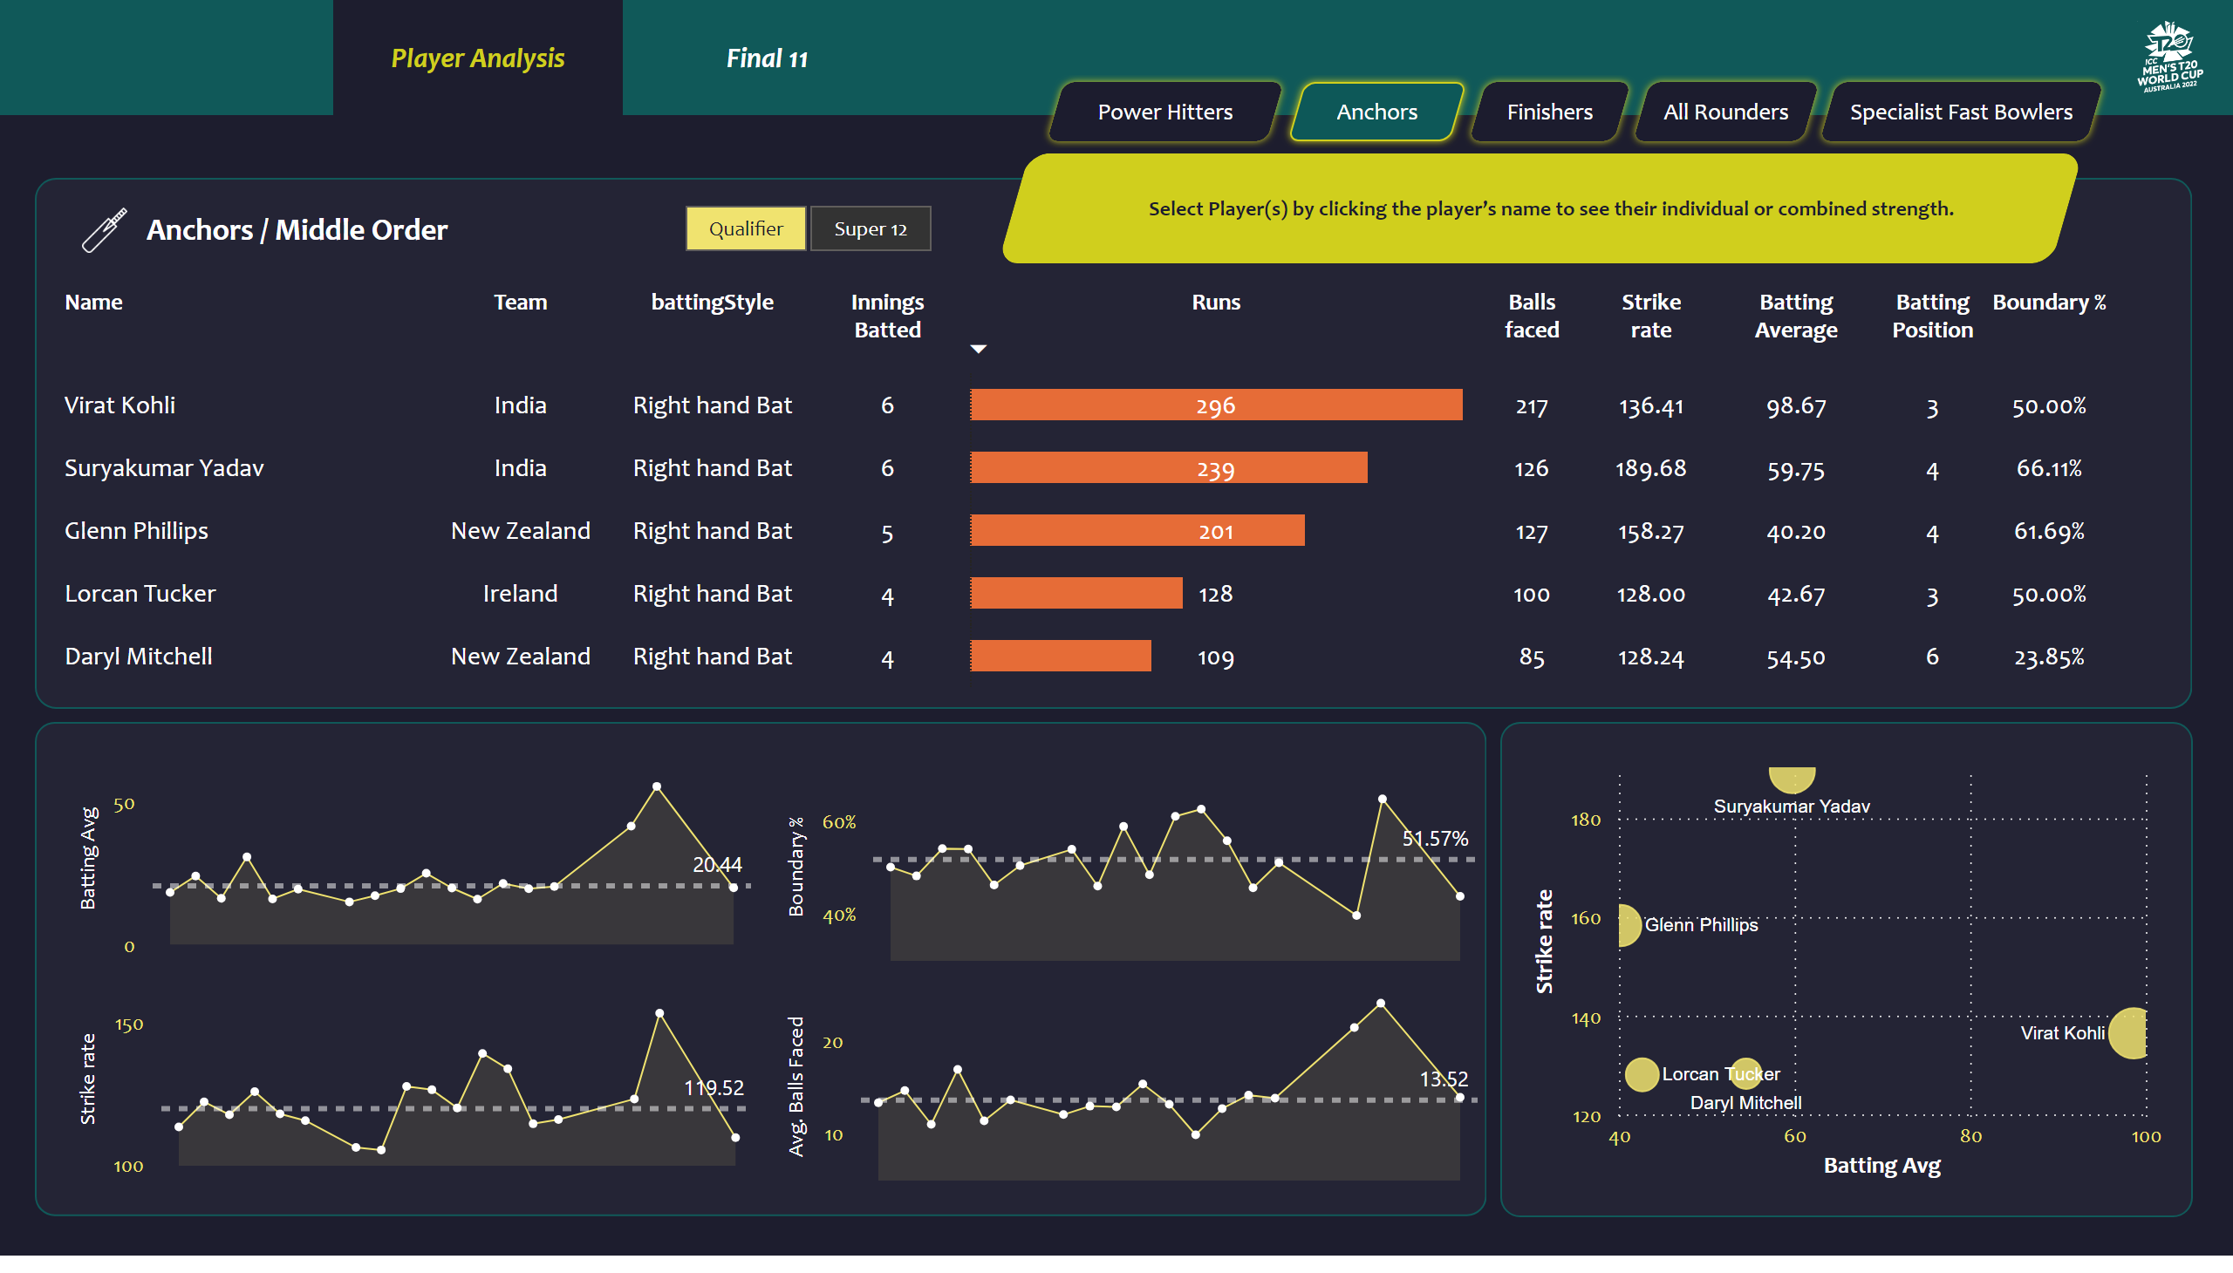
New Anchors / Middle Order
Notes:
slicer
No alt text provided
image
No alt text provided
shape
No alt text provided
actionButton
No alt text provided
actionButton
No alt text provided
actionButton
No alt text provided
actionButton
No alt text provided
actionButton
No alt text provided
shape
No alt text provided
shape
No alt text provided
card
No alt text provided
card
No alt text provided
card
No alt text provided
card
No alt text provided
shape
No alt text provided
areaChart
No alt text provided
shape
No alt text provided
areaChart
No alt text provided
areaChart
No alt text provided
areaChart
No alt text provided
shape
No alt text provided
image
No alt text provided
shape
No alt text provided
tableEx
No alt text provided
scatterChart
No alt text provided
Button Player Ana selected
No alt text provided
Button Player Ana selected
No alt text provided
shape
No alt text provided

Slide 4
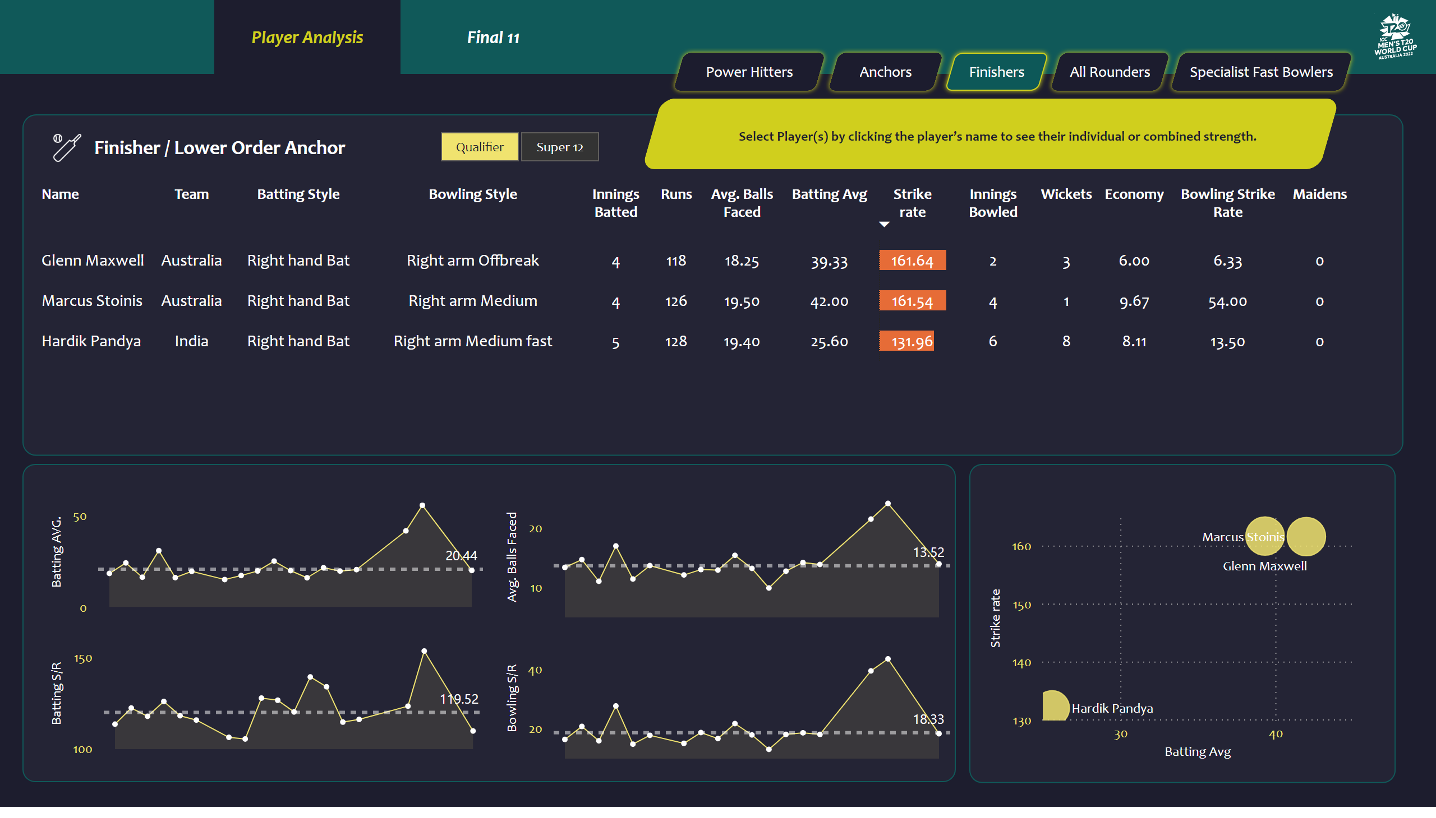
New Finisher / Lower Order Anchor
Notes:
tableEx
No alt text provided
slicer
No alt text provided
image
No alt text provided
image
No alt text provided
shape
No alt text provided
shape
No alt text provided
actionButton
No alt text provided
actionButton
No alt text provided
actionButton
No alt text provided
actionButton
No alt text provided
actionButton
No alt text provided
shape
No alt text provided
shape
No alt text provided
card
No alt text provided
card
No alt text provided
card
No alt text provided
card
No alt text provided
shape
No alt text provided
areaChart
No alt text provided
shape
No alt text provided
areaChart
No alt text provided
areaChart
No alt text provided
areaChart
No alt text provided
shape
No alt text provided
scatterChart
No alt text provided
Button Player Ana selected
No alt text provided
Button Player Ana selected
No alt text provided
shape
No alt text provided

Slide 5
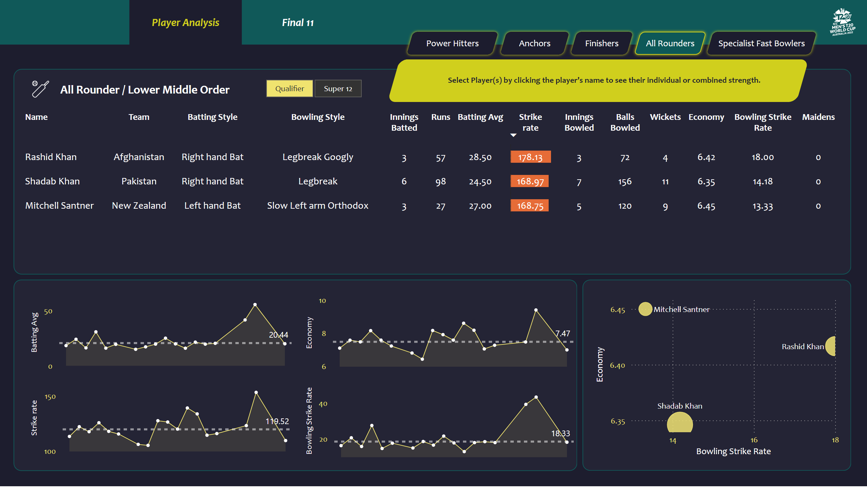
New All Rounders / Lower Middle Order
Notes:
tableEx
No alt text provided
slicer
No alt text provided
image
No alt text provided
image
No alt text provided
shape
No alt text provided
shape
No alt text provided
actionButton
No alt text provided
actionButton
No alt text provided
actionButton
No alt text provided
actionButton
No alt text provided
actionButton
No alt text provided
shape
No alt text provided
shape
No alt text provided
card
No alt text provided
card
No alt text provided
card
No alt text provided
card
No alt text provided
shape
No alt text provided
areaChart
No alt text provided
shape
No alt text provided
areaChart
No alt text provided
areaChart
No alt text provided
areaChart
No alt text provided
shape
No alt text provided
scatterChart
No alt text provided
Button Player Ana selected
No alt text provided
Button Player Ana selected
No alt text provided
shape
No alt text provided

Slide 6
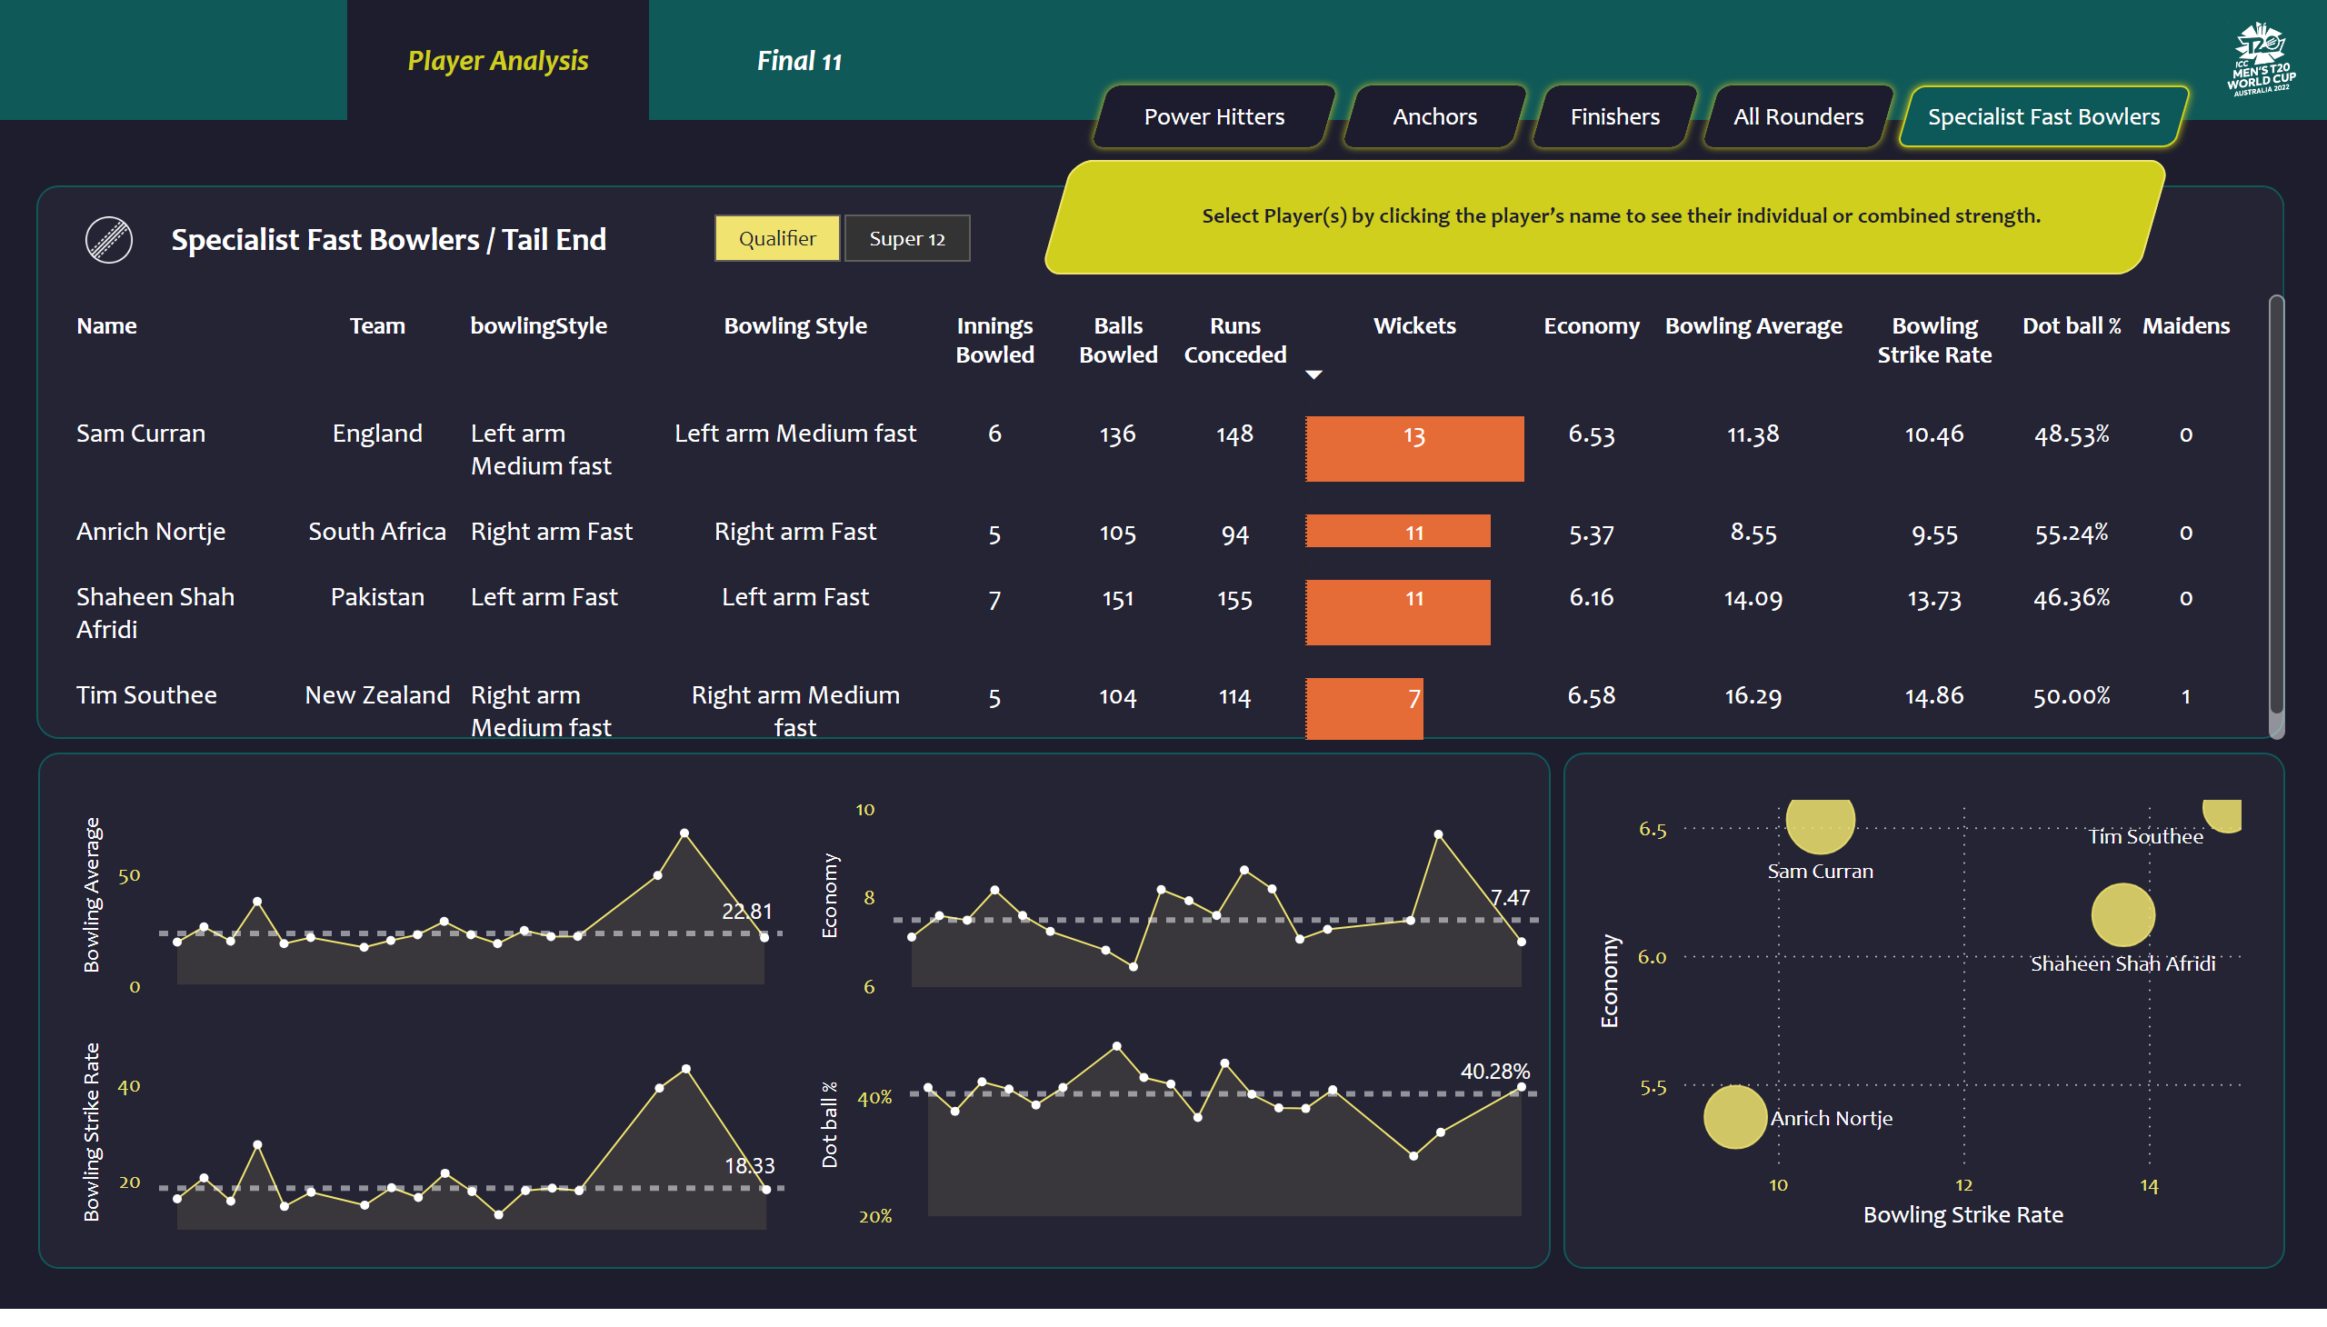
New Specialist Fast Bowlers / Tail End
Notes:
tableEx
No alt text provided
slicer
No alt text provided
image
No alt text provided
shape
No alt text provided
Button Anchores
No alt text provided
Button Power Hitters
No alt text provided
Button Finishers
No alt text provided
Button All Rounders
No alt text provided
Button Fast Bowler selected
No alt text provided
shape
No alt text provided
shape
No alt text provided
card
No alt text provided
card
No alt text provided
card
No alt text provided
card
No alt text provided
shape
No alt text provided
areaChart
No alt text provided
shape
No alt text provided
areaChart
No alt text provided
areaChart
No alt text provided
areaChart
No alt text provided
shape
No alt text provided
image
No alt text provided
shape
No alt text provided
scatterChart
No alt text provided
Button Player Ana selected
No alt text provided
Button Player Ana selected
No alt text provided
shape
No alt text provided

Slide 7
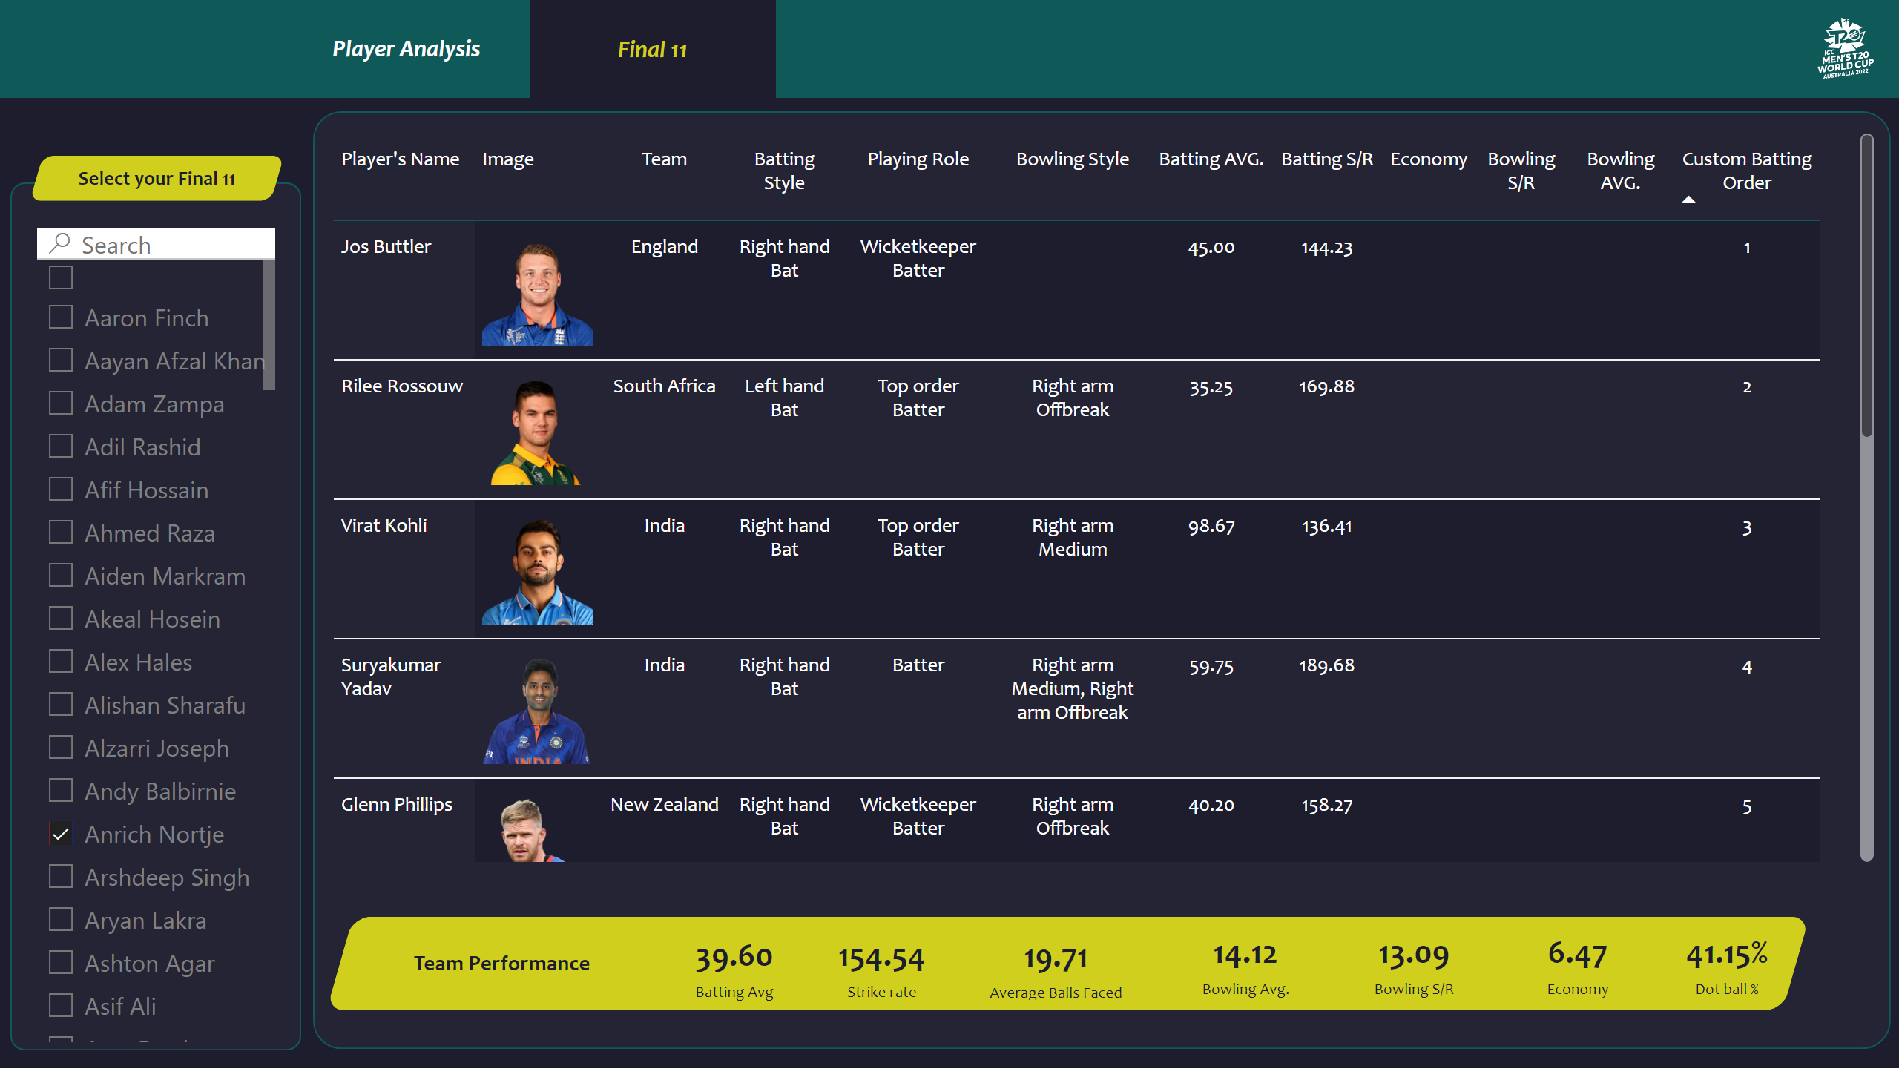
New Final12
Notes:
image
No alt text provided
shape
No alt text provided
shape
No alt text provided
Button Player Ana selected
No alt text provided
Button Player Ana selected
No alt text provided
slicer
No alt text provided
shape
No alt text provided
shape
No alt text provided
pivotTable
No alt text provided
shape
No alt text provided
card
No alt text provided
card
No alt text provided
card
No alt text provided
card
No alt text provided
card
No alt text provided
card
No alt text provided
card
No alt text provided
shape
No alt text provided

Slide 8
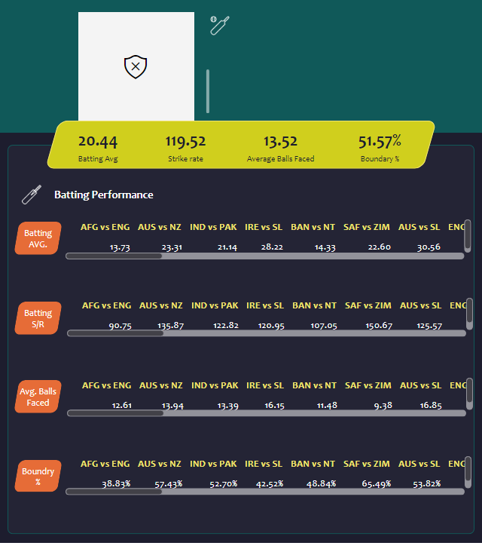
Batters- player details by match All Rounder
Notes:
textbox
No alt text provided
simpleImageEBC4593F96F1425FB3D84C5BF02B5075
No alt text provided
shape
No alt text provided
shape
No alt text provided
shape
No alt text provided
shape
No alt text provided
image
No alt text provided
shape
No alt text provided
card
No alt text provided
card
No alt text provided
card
No alt text provided
card
No alt text provided
shape
No alt text provided
shape
No alt text provided
shape
No alt text provided
shape
No alt text provided
shape
No alt text provided
pivotTable
No alt text provided
shape
No alt text provided
shape
No alt text provided
image
No alt text provided
pivotTable
No alt text provided
pivotTable
No alt text provided
pivotTable
No alt text provided

Slide 9
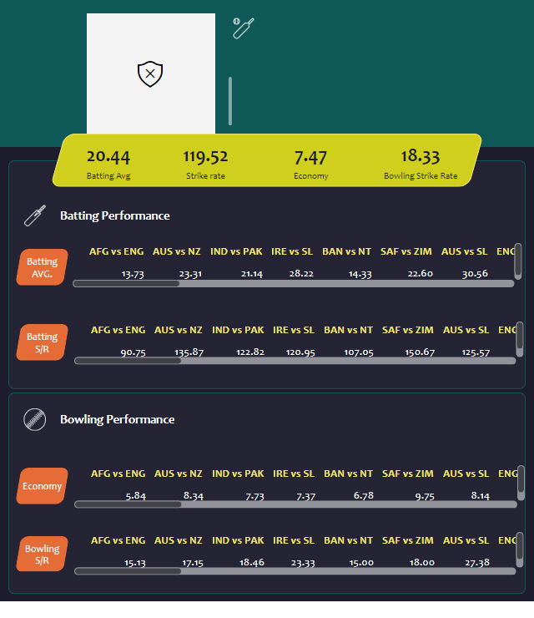
All Rounder /Low
Notes:
textbox
No alt text provided
simpleImageEBC4593F96F1425FB3D84C5BF02B5075
No alt text provided
shape
No alt text provided
shape
No alt text provided
shape
No alt text provided
shape
No alt text provided
image
No alt text provided
shape
No alt text provided
card
No alt text provided
card
No alt text provided
card
No alt text provided
card
No alt text provided
shape
No alt text provided
shape
No alt text provided
shape
No alt text provided
shape
No alt text provided
shape
No alt text provided
shape
No alt text provided
shape
No alt text provided
image
No alt text provided
shape
No alt text provided
shape
No alt text provided
image
No alt text provided
pivotTable
No alt text provided
pivotTable
No alt text provided
pivotTable
No alt text provided
pivotTable
No alt text provided

Slide 10
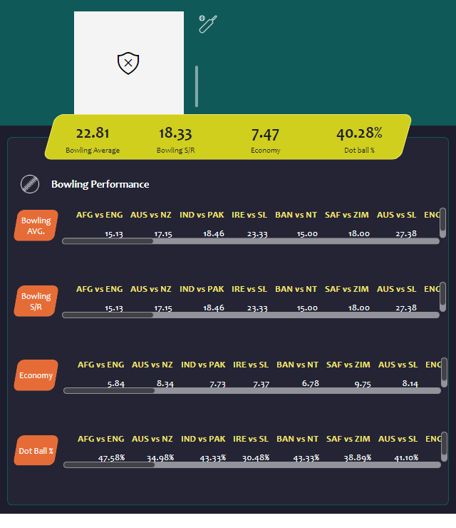
Bowler- player details by match All Rounder
Notes:
textbox
No alt text provided
simpleImageEBC4593F96F1425FB3D84C5BF02B5075
No alt text provided
shape
No alt text provided
shape
No alt text provided
shape
No alt text provided
shape
No alt text provided
image
No alt text provided
shape
No alt text provided
card
No alt text provided
card
No alt text provided
card
No alt text provided
card
No alt text provided
shape
No alt text provided
shape
No alt text provided
shape
No alt text provided
shape
No alt text provided
shape
No alt text provided
pivotTable
No alt text provided
shape
No alt text provided
shape
No alt text provided
image
No alt text provided
pivotTable
No alt text provided
pivotTable
No alt text provided
pivotTable
No alt text provided

